Slide 1
CSCI 631 Foundations of Computer Vision
Ifeoma Nwogu
ion@cs.rit.edu
Logistic Regression

Slide 2
Schedule
Last 2 classes
Classifiers
Nearest neighbor
SVM with different kernels
Today
Regression vs. classification
Logistic Regression classifier
Readings for today:
Intro to Statistical Learning in R (pages 128-138) – link provided on myCourses

Slide 3
Supervised vs. unsupervised learning
Unsupervised learning - x₁, x₂ …......x_{N}
No labels given
Goal is to determine the natural clusters of data
Useful for segmentation and other unconstrained learning
Supervised learning - (x₁,y₁)…......(x_{N},y_{N})
Class labels are provided for the data given
Goal is to learn
what characterizes each class (different from other classes) and
how to assign a new point to the right class

Slide 4
Two forms of supervised learning
Regression – used to predict continuous values
Find a surface that best conforms to the distribution of the data
Classification – used to predict the class of a data point
Find the decision boundaries that best separate different classes of data
Other forms of learning - reinforcement learning, transfer learning etc.

Slide 5
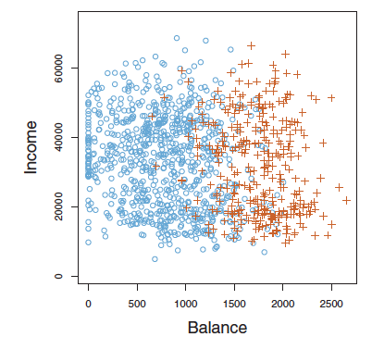
Regression or Classification Problem? Why?
Goal: Given the income and balance values of a client, find out if he/she would default on credit card payment
Example taken from Intro to Stat Learning in R

Slide 6
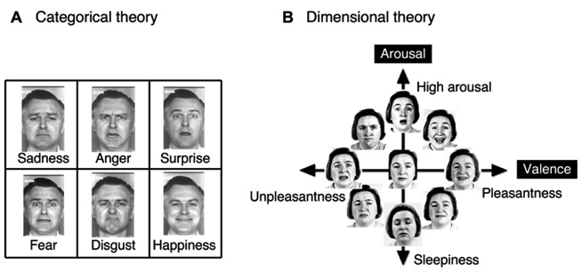
Regression vs. classification in computer vision
Most problems in computer vision are more related to classification than regression

Slide 7
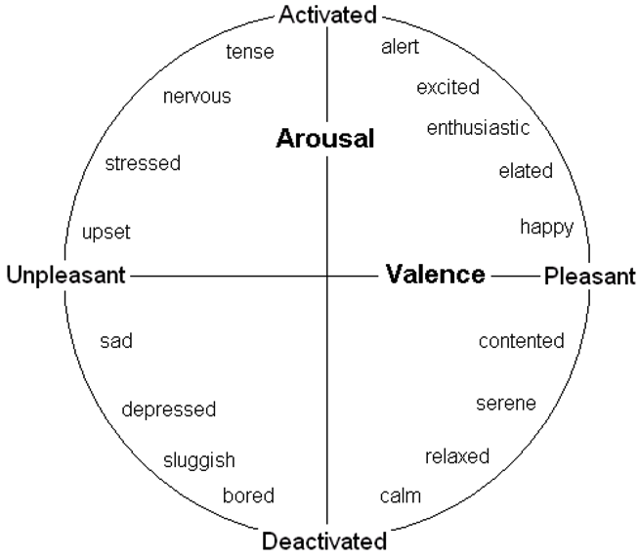
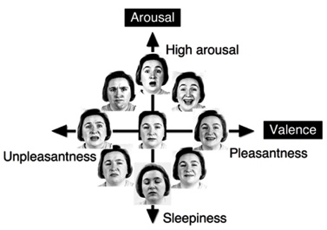
Example of image-driven regression
Facial expression analysis using the dimensional theory of emotion

Slide 8
Image-driven classification
One of the longest standing problems in vision
Land mass analysis, botany, robotics, scene recognition, document analysis, satellite imagery, astronomy, etc
See Kaggle.com for several image classification competitions

Slide 9
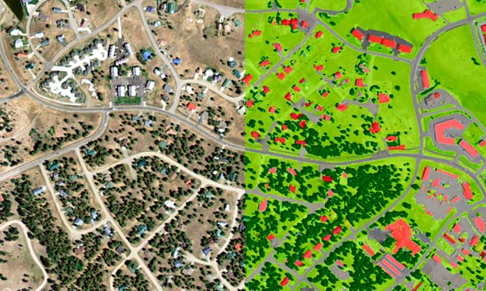
Classification example
Image from Land Info website

Slide 10
Classification strategies
Non-parametric
nearest neighbor
Probabilistic
histogram
logistic regression
Decision boundary
SVM

Slide 11
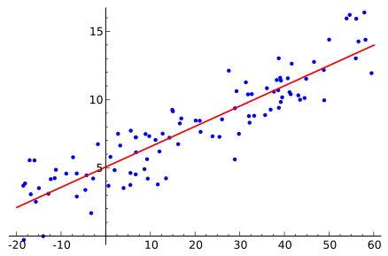
Linear regression review
Given a set of points (x₁,y₁)…......(x_{N},y_{N}),
Find the linear model that best fits the points
Note that y_{i} is a continuos value
(the dependent variable)
Image by Sewaqu - https://commons.wikimedia.org/w/index.php?curid=11967659

Slide 12
Components of the learning process
Extract features of interest from images
Determine your general prediction function
Parameters will need to be learned
Adopt a cost/error/loss function to learn the optimal parameter values
Evaluate the classifier performance

Slide 13


Linear regression continued
Given a data set with n points:
We assume a linear regression model, so that
In matrix form, we now have:

Slide 14
Logistic regression as an extension of linear regression
Linear Regression
Logistic regression
σ(z) =
σ(z) = tanh(z) or
x_{i1}
w₁
x_{i1}
w₁
*
y_{i}
*
y_{i}
+
σ
?
?
x_{i2}
x_{i2}
*
w₂
*
w₂

Slide 15
Components of the logistic regression process
Extract features of interest from images
Determine your general prediction function
Parameters will need to be learned
Adopt a cost/error/loss function to learn the optimal parameter values
Evaluate the classifier performance

Slide 16
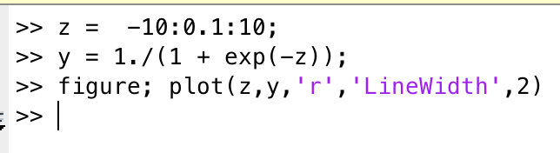
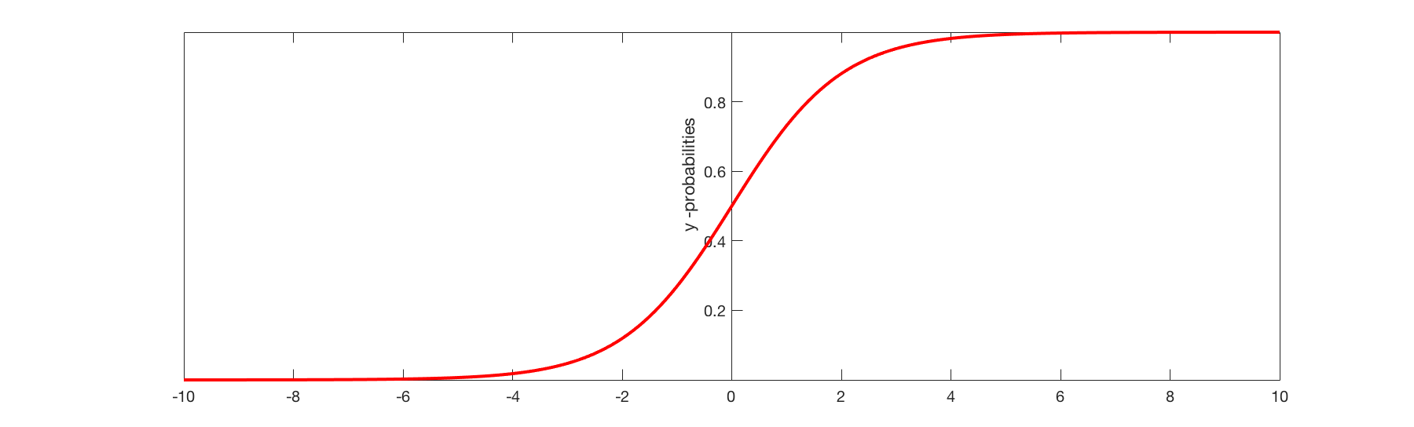
Logistic regression – prediction function
The sigmoid function σ(z) =
y_intercept is 0.5;
Predictor function
y = σ(W^{T}x)

Slide 17
Logistic regression – prediction function
The prediction function σ(.) =
we are given X, how can we get W?
try random guesses?
accuracy = 25%, 34%, constantly changing, highly unstable!!!
Find the optimal solution for W using a cost function

Slide 18
Components of the logistic regression process
Extract features of interest from images
Determine your general prediction function
Parameters will need to be learned
Adopt a cost/error/loss function to learn the optimal parameter values
Evaluate the classifier performance

Slide 19

Logistic regression-loss function
Cross-entropy loss function
J = - {t log(y) + (1-t) log(1-y)}, where
t = target label
y = predicted label (from the logistic regression)
For all the training examples,
Compare with mean squared loss:

Slide 20
Working with loss functions
Having experience with different loss functions based on the nature of your data and parameters
Maximizing the likelihood function (related to above)

Slide 21


Gradient descent
In vector form,
For the bias term,

Slide 22
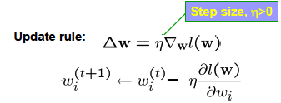
Gradient descent
We use gradient descent to find the optimal weights for the predictions
J(w) is a convex function (-ve sign), no local optima
But no closed form solution to maximize J
Convex functions easy to optimize with gradient descent
Write the expression for the the gradient of J(w)
Use an update rule to traverse the space until a min is reached

Slide 23
Logistic regression as a classifier
Does not work as well when classes are linearly well separated!
To address this problem, we use regularizers to induce penalties on the cost function
A multiclass extension of LR is called the softmax classifier which we will use later
Linear discriminant analysis (LDA) and naïve Bayes classifiers are special cases of LR

Slide 24
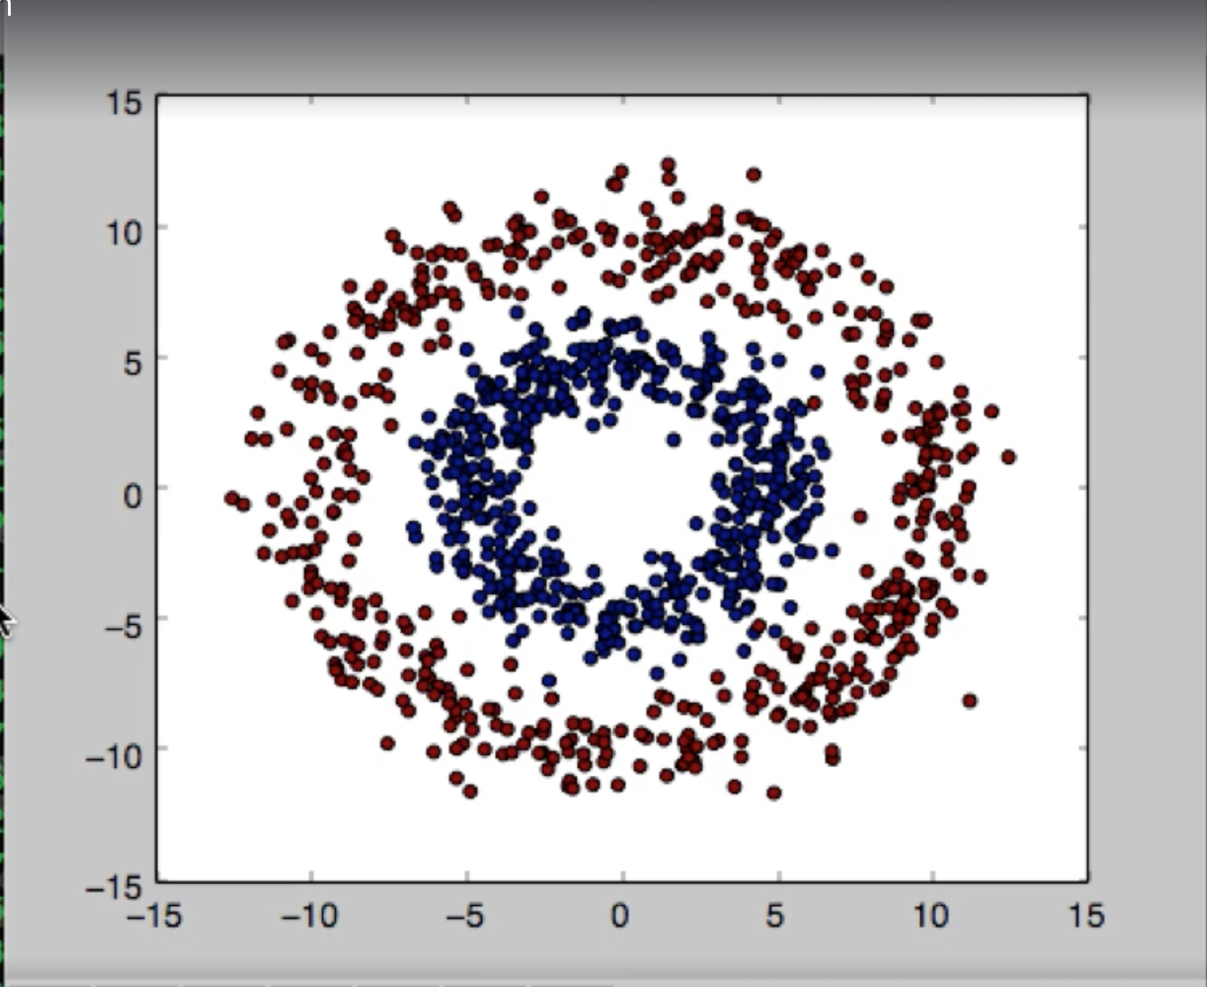
The donut problem
How can we use LR to classify this dataset?

Slide 25
Components of the logistic regression process
Extract features of interest from images
Determine your general prediction function
Parameters will need to be learned
Adopt a cost/error/loss function to learn the optimal parameter values
Evaluate the classifier performance

Slide 26
Classifiers: Crucial Points
Classifiers accept features, return decision
and are often trained using data
Very mature training processes now
Always try standard methods first
SVM
kNN
Logistic regression
Evaluate with separate test data
look at total error rate
ROC
class confusion matrix
(occasionally) total risk
typically when one has a loss model

Slide 27
Summary: Classifiers
Nearest-neighbor and k-nearest-neighbor classifiers
Support vector machines
Linear classifiers
Margin maximization
Non-separable case
The kernel trick
Multi-class SVMs
Logistic regressor (pre-cursor to neural networks)
There are so many other classifiers out there
Nneural networks, boosting, decision trees/forests, …

Slide 28
Evaluating binary classifiers
Always
train on training set, check on validation set, evaluate on test set
test set performance might/should be worse than training set
Options
Error rates
Total error must be less than 50% for two classes
Receiver operating curve
When we use a hand-tuned parameter (e.g.threshold)
we might use different thresholds
Class confusion matrix
for multiclass

Slide 29
Evaluating classifiers
Always
train on training set, evaluate on validation dataset, final test on test data
test set performance might/should be worse than training set
Options
Total error rate
always less than 50% for two class
Receiver operating curve
because we might use different thresholds
Class confusion matrix
for multiclass
Average precision

Slide 30
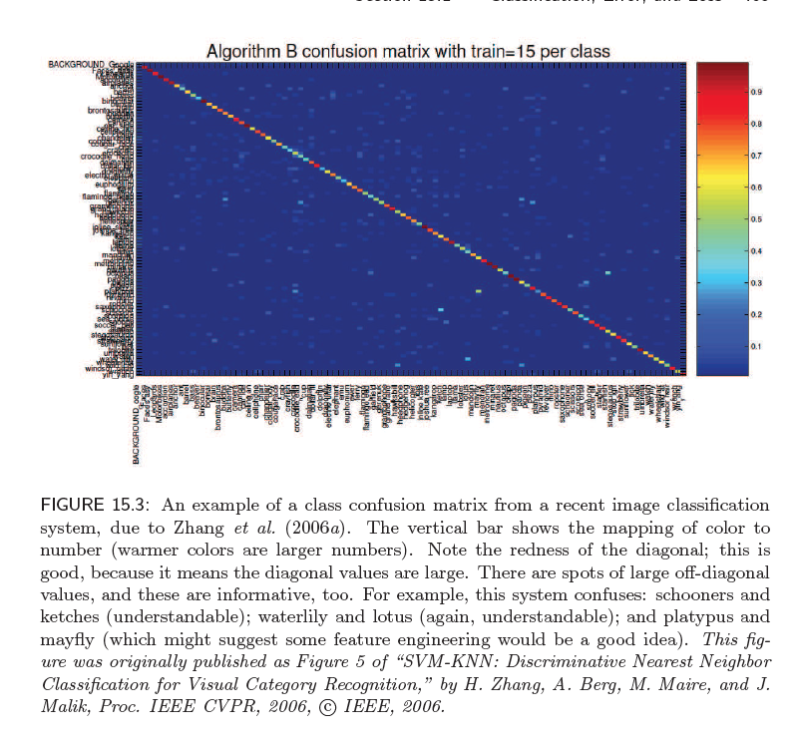
Confusion Matrix

Slide 31
Evaluating a binary classifier
+
-
Actuals
+
True
Positive
False
Positive
Classification rate =
Predicted
-
False
Negative
True
Negative
Also known as accuracy
We want to maximize TP and TN
We want to minimize FP and FN

Slide 32
Evaluating a binary classifier
+
-
Actuals
+
True
Positive
False
Positive
Misclassification rate =
Predicted
-
False
Negative
True
Negative
Also known as error rate

Slide 33
Evaluating a binary classifier cont’d
+
-
Actuals
+
True
Positive
False
Positive
Precision =
Predicted
Recall =
-
False
Negative
True
Negative
Precision: When it predicts yes, how often is it correct?
Recall: When it's actually yes, how often does it predict yes?
- Recall is also known as TPR or sensitivity

Slide 34
Evaluating a binary classifier cont’d
+
-
Actuals
+
True
Positive
False
Positive
Specificity =
Predicted
Sensitivity =
-
False
Negative
True
Negative
Sensitivity: Can it mostly find what it’s looking for
Specificity: Can it mostly not mistake something else
for what it’s looking for

Slide 35
Evaluating a binary classifier cont’d
+
-
Actuals
+
True
Positive
False
Positive
F1-score =
Predicted
-
False
Negative
True
Negative
Also known as F-score or F-measure

Slide 36
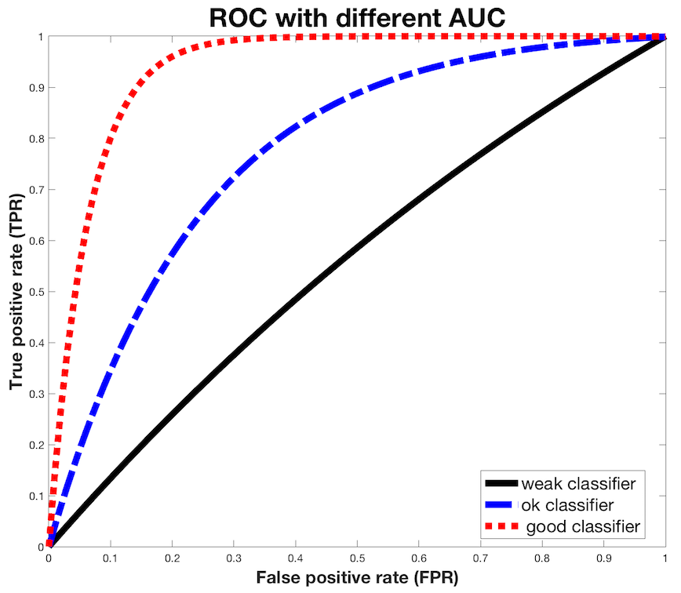
ROC and AUC
Threshold does not have to be 0.5;
we can use any threshold
TPR =
FPR =
ROC is generated by
Plotting TPR vs. FPR
for many threshold values
AUC – area under the curve
indicates the goodness of the
classifier

Slide 37
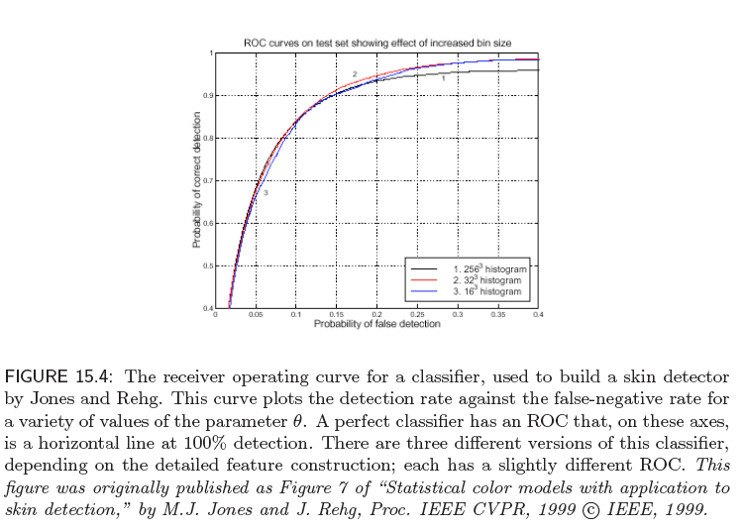
Receiver operating curve

Slide 38
Diagnostic testing example
 | True Disease State
 |  | Diseased (+) | Healthy(-) | Total
Test results | Diseased (+) | 44 | 10 | 54
 | Healthy(-) | 23 | 60 | 83
 | Total | 67 | 70 | 137
Total of 137 people
67 sick, 70 healthy
Acc = 104/137 = 76%
Prec = 44/54 = 81%
TPR = 44/67 = 65.6%
FPR = 10/70 = 14.3%
TPR is the percentage of tested
individuals who correctly
receive a positive test result.
FPR is the percentage of healthy
individuals who incorrectly
receive a positive test result.
Notes:
REM TPR is sensitivity.

Slide 39
Sensitivity and Specificity
Sensitivity (TPR or recall) measures the proportion of actual positives that are correctly identified as such
rarely overlooks what it is looking for
Specificity (TNR) measures the proportion of actual negatives that are correctly identified as such
rarely mistakes something else for what it is looking for
For practical reasons, tests in medical diagnosis with sensitivity and specificity values above 90% have high credibility
Notes:
REM TPR is sensitivity.

Slide 40
Melanoma testing example
 | True Disease State
 |  | Diseased (+) | Healthy(-) | Total
Test results | Diseased (+) | 0 | 0 | 0
 | Healthy(-) | 2 | 98 | 100
 | Total | 2 | 98 | 100
Total of 100 people tested
2 sick, 98 healthy
Acc = 98/100 = 98%
Sensitivity = 0/2 = 0%
Specificity = 98/98 = 100%
Notes:
REM TPR is sensitivity.

Slide 41

Questions

